Slide 1
Words on a Page
Mackenzie Beck
Story Questions Assignment

Slide 2
Themes
Theme 1- Courage – In the story Lenore need courage in a couple different places. The first one is after she reads her story to the class and finds out she can go to Thunder Bay in a writing competition. She is afraid to ask her father about going at first because she is afraid he will say no. When she does ask him he ends up saying no but she gets the courage and she fought for what she believed in until her father did say yes. Another one is where she is on the way to Thunder Bay and she is questioning whether or not to read her story in front of judges. She ends up getting the courage to read her story and in the end the judges stood up and applauded her.
Theme 2- Follow your Heart – In the story Lenore set her mind on something she really wanted and she fought for it with some help from some other people. Lenore really wants to write, and read her story in Thunder Bay. When her father says no she doesn’t give up on trying, she gets her mother and her teacher to try and talk reason into her father so that he sees it the way Lenore does. Even though Lenore doesn’t keep pestering her father she still is trying to get him to understands that this is what she really wants to do with her life.

Slide 3
Setting
This story took place in Spirit Bay, BC. They also end up in Thunder Bay, ON, at the end of the story. It takes place in modern time during the school year. If the story took place in Ontario or somewhere a lot closer to Thunder Bay, it would probably be different. If Lenore went to school close to Thunder Bay she her father probably wouldn’t have to give permission and they could go to the university for the day. Lenore probably would have more opportunities to do big things like this because she lives closer to the competition. If Lenore and her family lived in a mostly white part of Canada she probably wouldn’t be accepted as much. If they were so different they would probably care much more about their culture and keeping it alive so Lenore might not have had the opportunity to do the reading competition. Her father probably would have been judged a lot more if people also knew he couldn’t read. If the story was set in a different time like 1905, Lenore and her family wouldn’t be very accepted within white people. Her family probably wouldn’t have been seen as people and they could have been denied education so Lenore wouldn’t have had the opportunity to even write a story if she didn’t know how to read or write like her father.

Slide 4
Lenore
Lenore is a Teenage Ojibway girl in grade 10 who loves to write stories. She lives in Spirit Bay, BC with her mother Connie, her father Pete, and her sister Sadie. She loves to write and her English teacher Ms. Walker is very supportive and encouraging to her and her writing. When Lenore gets her story selected for a contest in Thunder Bay, all of her family is very supportive by the end. In the beginning her father isn’t very happy about her going to Thunder Bay because he is afraid. Once he faces his fears he is supportive and happy for Lenore.

Slide 5
Sadie
Sadie is Lenore’s younger Ojibway sister. She lives with Lenore, Connie, and Pete. Ms. Walker is also her English teacher but she isn’t in the same class as Lenore. Sadie is very supportive and excited for Lenore to go to Thunder Bay. Sadie can be a bit of a pain like when Lenore gets the news that her story was selected, Lenore is nervous but Sadie is anxious to tell her father the good news so she sets Lenore up. She has a good relationship with her parents and sister even though she can be a bit of a pain sometimes.

Slide 6
Pete
Pete is a middle-aged Ojibway man, who lives in Spirit Bay with his family. His family includes his two daughters, Lenore and Sadie, and his wife Connie. He makes canoes for a living and he enjoys beaver hunting and fishing with his daughter Lenore. Pete doesn’t know how to read and he is afraid of Lenore forgetting her culture so he doesn’t approve of Lenore going to Thunder Bay. He doesn’t like the idea of school putting ideas in Lenore’s head to leave her family and go learn in a different place. Once he talks to Lenore about how he feels they understand each other and Pete supports Lenore as much as he can.

Slide 7
Connie
Connie is a middle-aged woman who lives in Spirit Bay, BC with her family of Lenore, Sadie, and Pete. Connie is kind of a shy woman but she supports her daughters and husband as much as she can. When Pete says no to Lenore going to the competition, Connie is afraid to talk to Ms. Walker about the situation but she does anyway because she is determined to get Pete to understand how Lenore feels about her writing.

Slide 8
Ms. Walker
Ms. Walker is an English teacher at the local school in Spirit Bay, BC. She teaches Lenore’s grade 10 English class and is very encouraging of Lenore’s writing and stories. She knows how much Lenore loves to write but she also tries to understand Pete’s side of the story. When she goes to Lenore’s house for supper she tries to get Pete to understand even though she doesn’t know his story.

Slide 9
The Initial Problem
Lenore wrote a really good story and read it in front of her class. Her teacher decided to enter it into a competition and Lenore was chosen. The trouble is, its all the way in Thunder Bay. Lenore gets the news only to find out her parents have to give signed permission for her to go. Lenore is afraid to tell her father because she is afraid he will say no because of his beliefs. When she does ask him, he says no and Lenore gets mad and leaves the room. Her mother knows how much Lenore wants this so she asks Ms. Walker to try and talk some sense into Pete. He also says no to Ms. Walker. Lenore and her family need to find a way to get Pete to see the situation the way Lenore sees it and for him to understand that this is what she wants.

Slide 10
Rising Action and Complications
When Lenore gets the chance to go to Thunder Bay to read a story she wrote, she asks her father if she is allowed to go and he tells her no. She spends the rest of the story trying to get her father to understand her situation. Her father also doesn’t know how to read or write. He doesn’t believe in education so he doesn’t think his kids should have to go to school and learn to read and write. Another complication is when Lenore asks her father to go to parents night to hear her story and she is really excited but he doesn’t show up.

Slide 11
The Climax Moment
I think the climax moment in the story is when Pete says yes to Lenore going to Thunder Bay. I think this is the climax because there isn’t too much tension right before the moment and there isn’t a lot of tension after he says yes.

Slide 12
Falling Action
I think the falling action in this story is when Lenore is preparing to go to Thunder Bay. It is when Lenore is reading the story because it kind of starts to wind the story down and leads up to the ending. This is the falling action because the climax has already happened when Pete said yes to Thunder Bay.

Slide 13
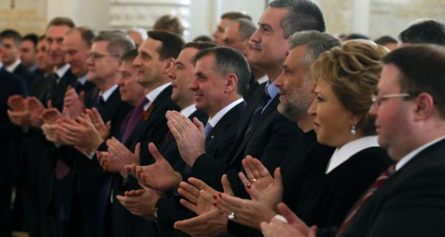
The Resolution
I think the resolution is when Lenore is reading her story with her fathers approval in Thunder Bay. The story ends with everyone silent in the auditorium. Her father stands up and starts to applaud her and eventually everyone including the judges gives her a standing ovation. It is this moment when you realize Lenore has her fathers approval for school and university and their conflict has been solved.

Slide 14
Responding to the Story
I think this story was a very inspiring story for some people. It tells people to follow your dreams even if not everyone approves. I think it ended in a good place even though the author could have said if she won the competition or not or how she did in the end. I personally couldn’t connect to the story very much but I can see how some people could really connect and use this story as inspiration to do something great of their own.

Slide 15
Character Motivation
Lenore – Lenore is motivated by her writing and her love for school and education. She really wants to keep learning and writing and possibly go to university. Her dad doesn’t believe in education so they have a conflict over education and Lenore going to Thunder Bay to read her story.
Sadie – Sadie doesn’t really develop throughout the story but she is motivated by her sister. She wants her sister to do well in school and go to university.

Slide 16
Character Motivation
Connie – Connie is motivated by her daughter. She really wants to help her daughter get the education she wants and help her go to university and do well in what she loves to do.
Pete – Pete is motivated by his beliefs. He doesn’t believe in education or school and he doesn’t know how to read and write. He thinks everyone shouldn’t have to go to school and he wants Lenore to stay in Spirit Bay and learn more about her culture and less about modern writing and other education. He is afraid that Lenore will leave Spirit Bay and forget about her family and her culture.
Ms. Walker – She wants Lenore to succeed as she does the rest of her students. She confronts Pete even thought she doesn’t know what his situation is like.

Slide 17
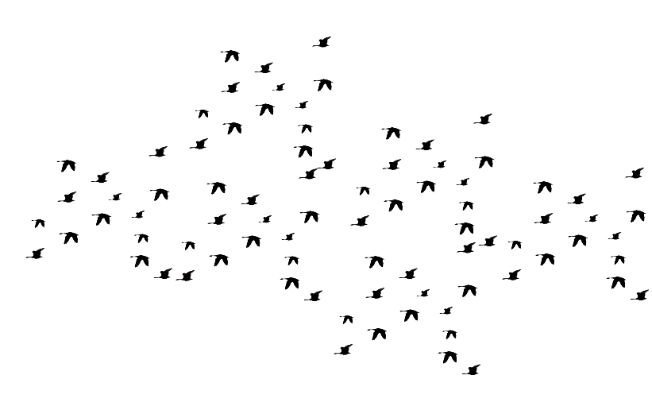
Benefits of the Story
I think all audiences can benefit from the story. Some people might not be able to connect the story to their personal lives but they could still learn from the story. It teaches people to fight for what you believe in no matter what your age is or culture. It is inspirational to people because if you were in a situation where you really wanted to do something and your parents didn’t approve, if they read this story they might be able to connect and find inspiration so they could get their parents to understand their situation.

Slide 18
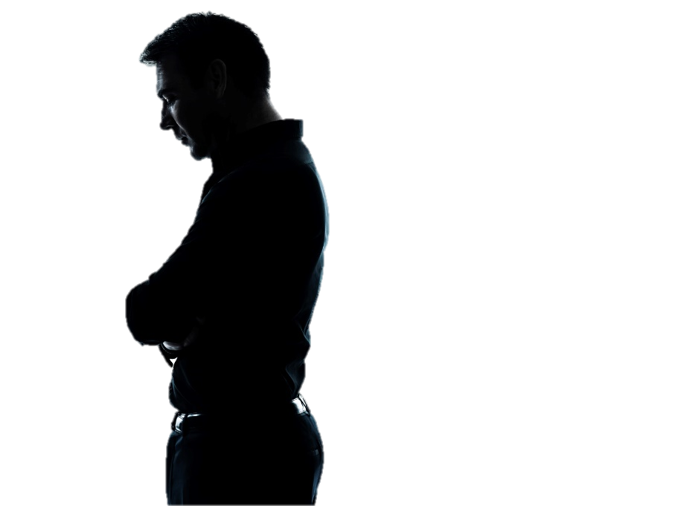
Conflict
There was a bit of both internal and external conflict in the story but it was mostly external about Lenore going to Thunder Bay. Pete and everyone else had a conflict about Lenore going to Thunder Bay and getting the education that she really wants. The internal conflict was in Lenore and in Pete. Lenore’s internal conflict was her being nervous about telling her father about Thunder Bay because she knew he was going to say no because of his beliefs. Pete had an internal conflict as well. He was nervous about telling his daughter he didn’t know how to read and also nervous about her forgetting where she comes from and her culture.

Slide 19
A Woman's Perspective
In the story there are two different woman with a bit of a different opinion. Ms. Walker, Lenore’s teacher, really wants Lenore to succeed no matter what anyone else thinks about it. She is upset about what Pete thinks about education even though she doesn’t quite fully understand his situation. Connie is a little bit less forward. She is kind of shy so she was afraid to even tell Ms. Walker about what Pete said. She told Lenore to be more patient and wait for the pieces to fall into place on their own, unlike Ms. Walker who is quite pushy to get what she wants.

Slide 20
Lenore and Pete
At the beginning of the story Lenore and Pete have a fairly good relationship but it has some issues. Lenore doesn’t know her fathers story very well she just thinks he doesn’t like school. She is afraid to share good news with him because she is afraid that he will not like it because of his beliefs. Pete is afraid if Lenore likes school too much, she will move on from Spirit Bay to go to University and forget about her culture and who she is. Their relationship is severely lacking in communication at the beginning. After they talk to each other and learn about what the other is thinking, their relationship improves a lot and they are a lot more trusting of each other.

Slide 21
Dreaming About Birds
I think Lenore’s dreams about birds symbolize her writing and her first nations culture. In her dreams, she sees blackbirds flying on snow to form words like painting on a canvas. Eventually the birds fly away. This could symbolize her first nations culture coming to a new land (a white land) and embracing their culture to teach other people about their culture with words and stories like Lenore's.

Slide 22
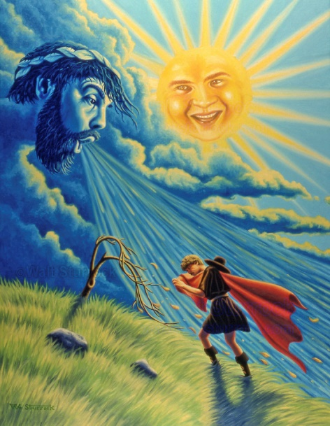
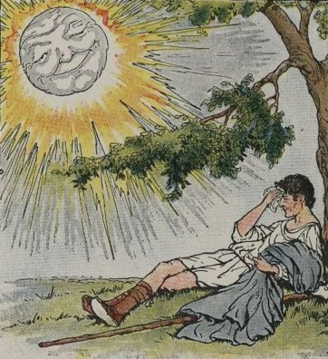
The Sun and the Wind
The sun and the wind were arguing one day about who was stronger. They saw a traveler wearing a coat and they decided whoever could get the man to take off his coat was the stronger one. The wind went first. The wind blew as hard as it could but that only caused the man to hug the coat to his body tighter. The wind gave up and then it was the sun’s turn. The sun shone as bright as it could and eventually the man took the coat off on his own. This story teaches people to be patient to get something you really want. This can help people in a conflict by telling them to just be patient and wait for people to just understand. When Lenore was getting angry at Pete about not letting her go to Thunder Bay, Connie told her this story and Lenore learned to be more patient and let other people figure things out on their own.

